Slide 1
COVID RAPID RESPONSE

Slide 2

The involvement of the Little Hands Organisation in COVID-19 situation to help the people who want their respective need of
Psychological Counselling For Covid
Oxygen
Guidance
Vaccinations
Blood requirements
Financial aid
Food Requirements

Slide 3

Details:
Covid Rapid Response team is a project that was initiated at the time of Covid. With the assistance of LHO, All the volunteers had run a call centres also along with a group of volunteers where the people in need can call and enquire about covid resources such as oxygen cylinders, beds, medication, food and doctor consultation etc. Our vision is to divide the volunteers into teams and scheduling the time according to the requests of the people, helped us to solve 1400 + cases in the entire duration of the project. This project has provided support for more than 15 districts of people over AP and Telangana.

Slide 4
About the Response in covid:
As the covid first wave attacked India. many people caused death and suffered a lot and in the month of April the virus again attacked as second wave.in this second wave alarmingly raised, we planned to start a helpline which will assist everyone and anyone who is needy with the available covid information we have. We have started it on may 1^{st.}
What we have done?
We have received around 5000+ calls. Out of which we have solved 1400+ cases. We have assisted around 128 online consultations with our volunteer doctors, helped 139 people financially. Most of the calls we are receiving are of the oxygen cylinder,140 member volunteers team across the world had worked round the clock for collecting the data ,digging and verifying finally passing it to the needy.

Slide 5
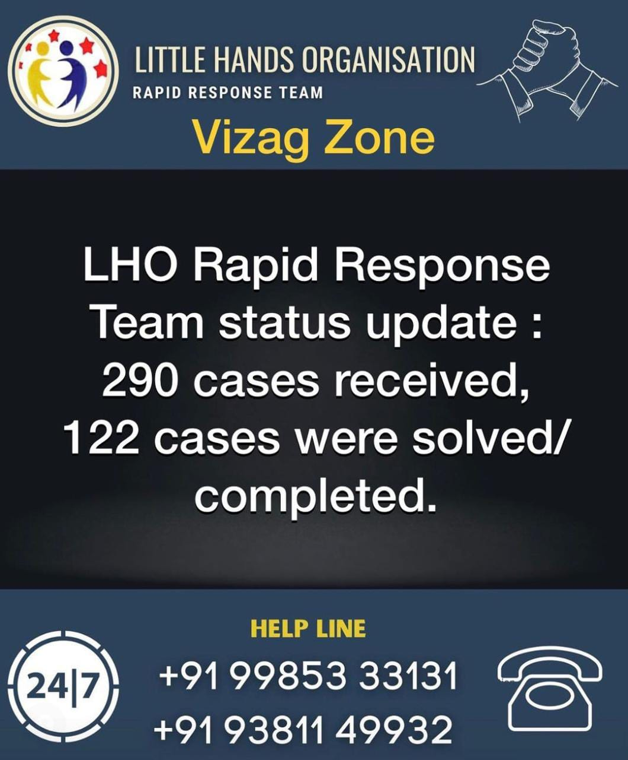
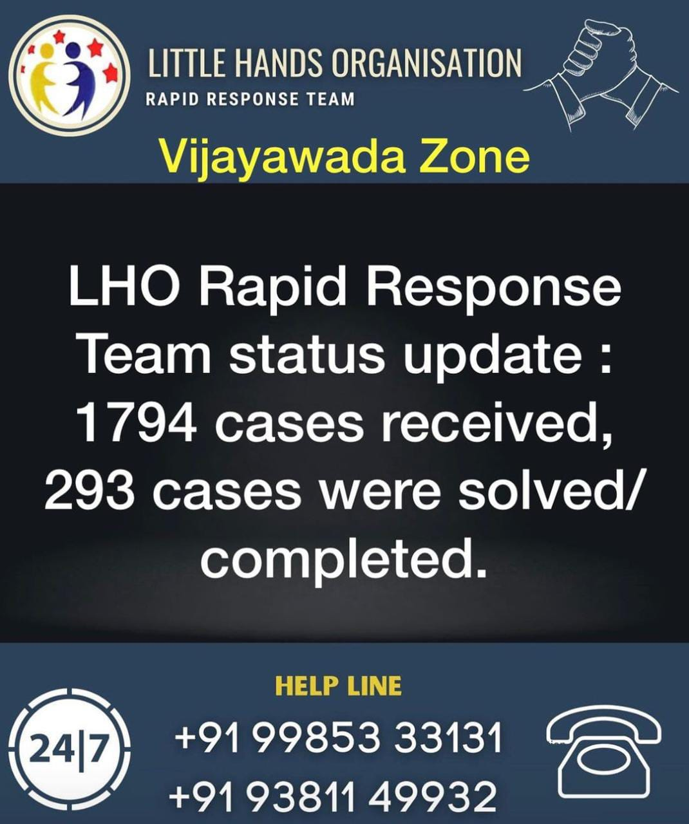
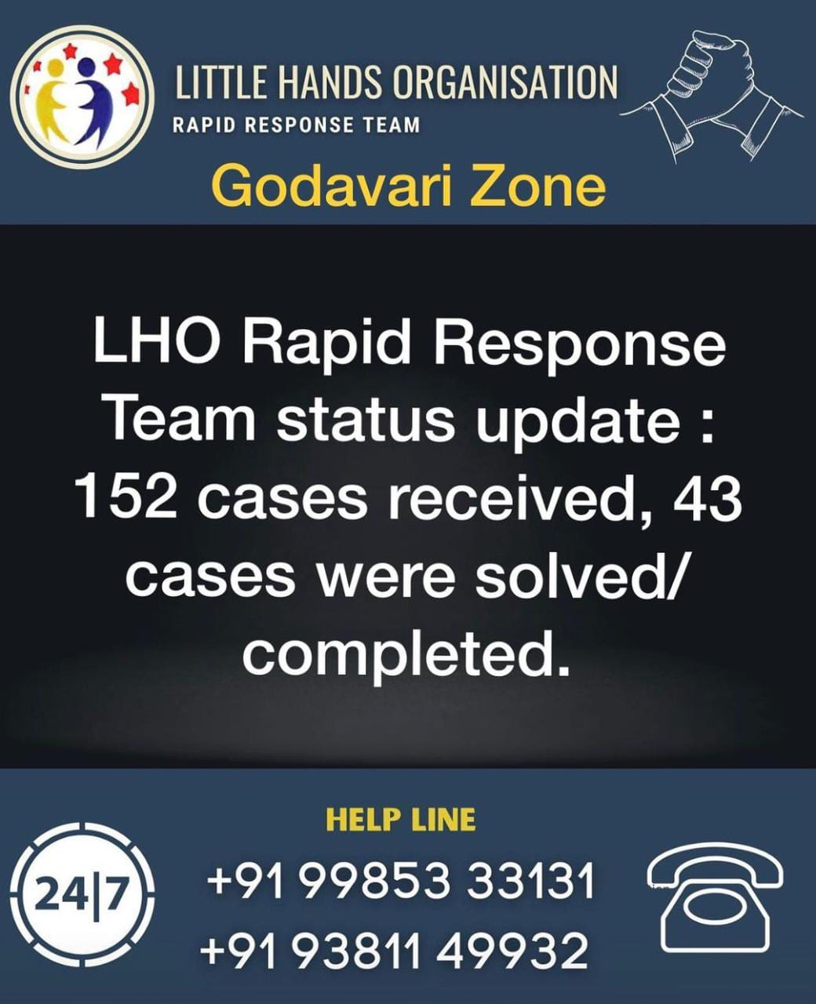
Responses we have solved in Zone wise

Slide 6
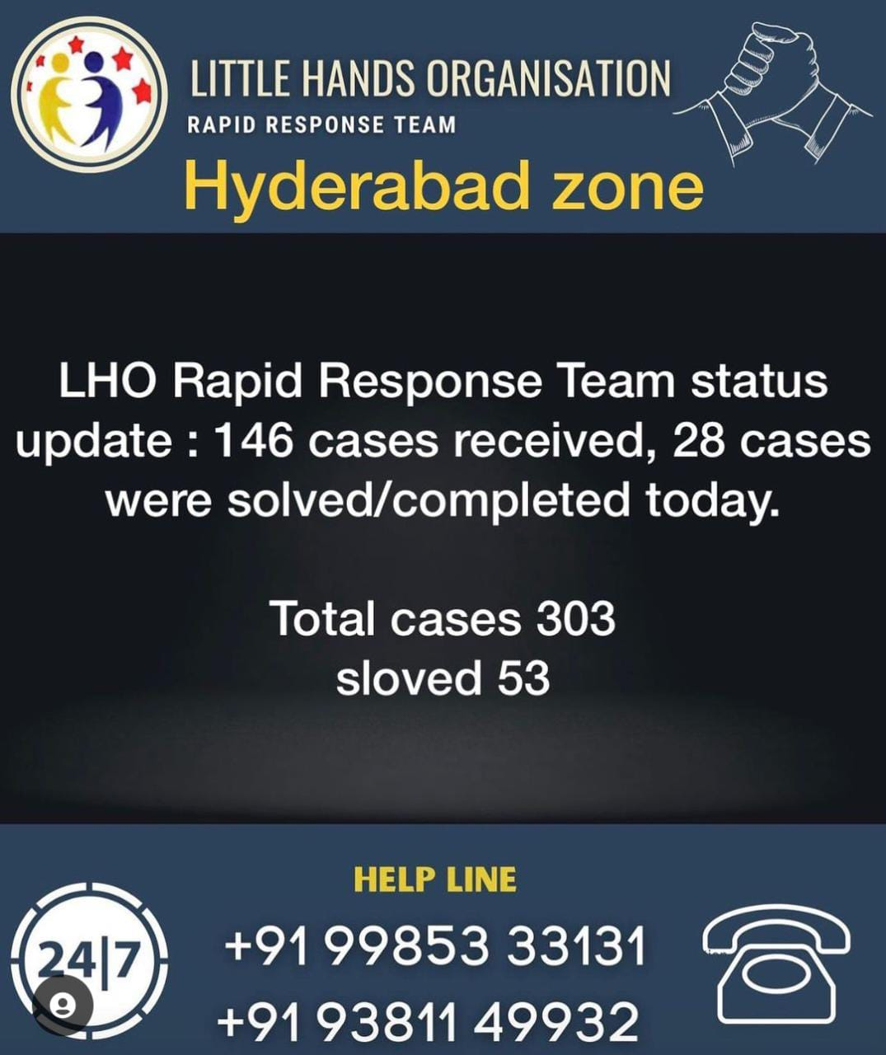
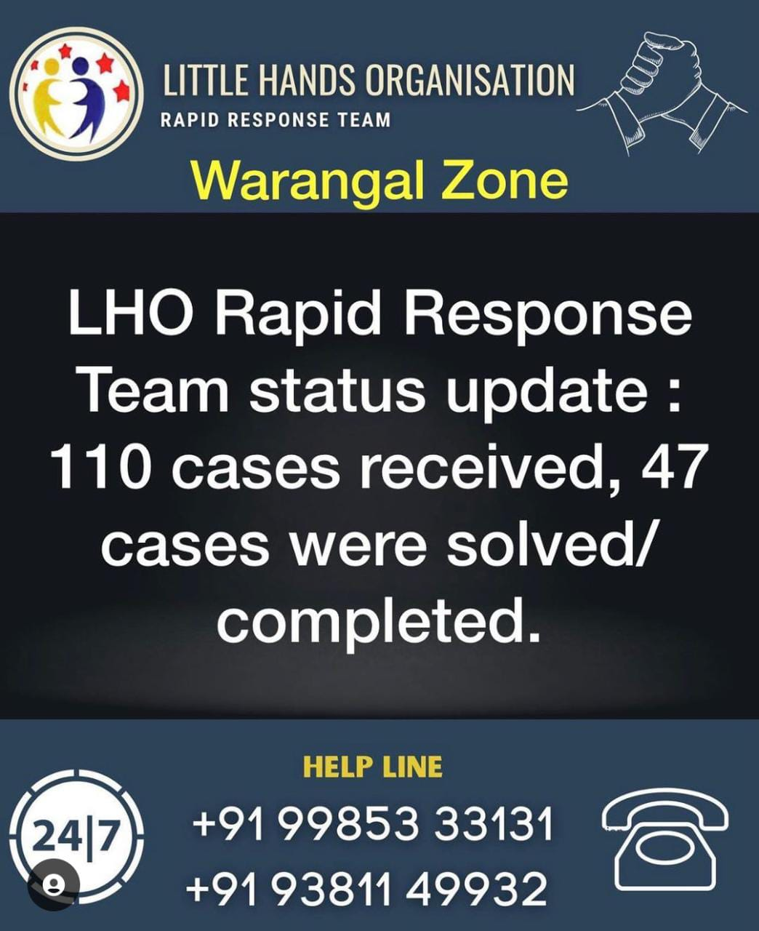
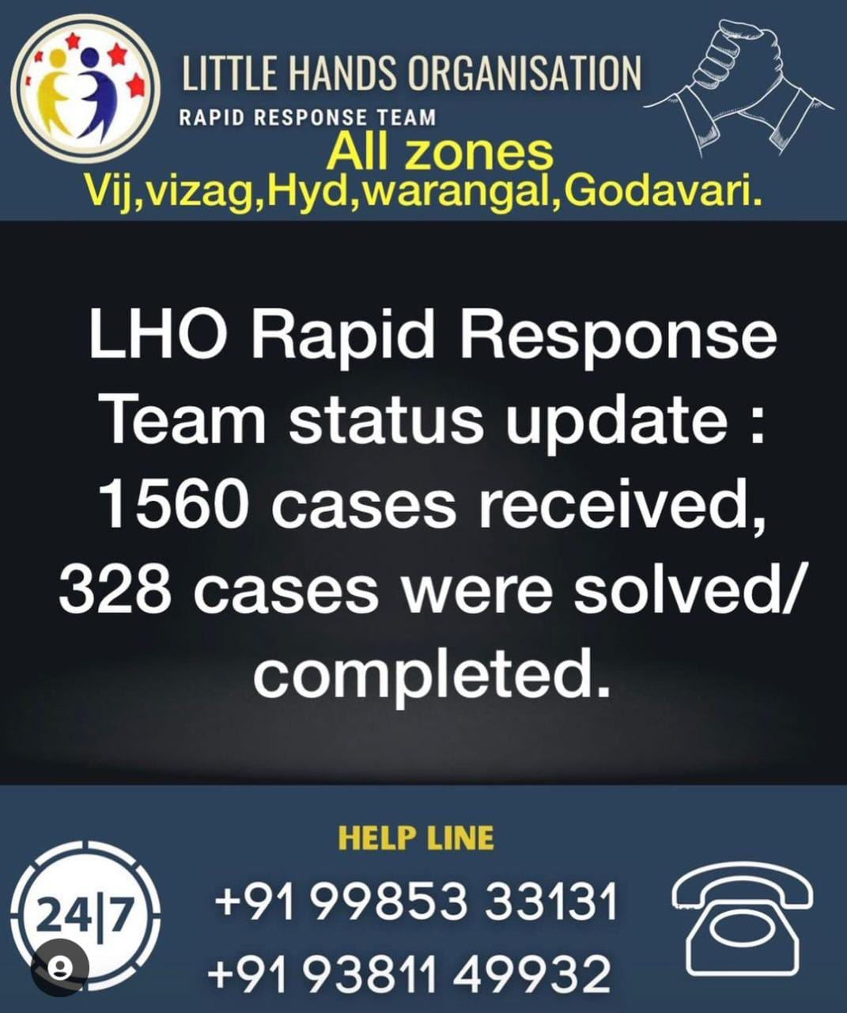

Slide 7
Coronavirus Disease(COVID-19): Vaccines
What vaccines are there against COVID-19 ?
There are several COVID-19 vaccines validated for use by WHO (given Emergency Use Listing). The first mass vaccination programme started in early December 2020 and the number of vaccination doses administered is updated on a daily basis on the COVID-19 dashboard. The WHO Emergency Use Listing process determines whether a product can be recommended for use based on all the available data on safety and efficacy and on its suitability in low- and middle-income countries. Vaccines are assessed to ensure they meet acceptable standards of quality, safety and efficacy using clinical trial data, manufacturing and quality control processes. The assessment weighs the threat posed by the emergency as well as the benefit that would accrue from the use of the product against any potential risks.
Which COVID-19 vaccine should I get?
All vaccines with WHO Emergency Use Listing are highly effective at preventing serious illness, hospitalization and death due to COVID-19. You should accept the vaccine you are offered first and get vaccinated as soon as it is your turn to reduce your risk. Do not delay getting vaccinated, unless advised to by your health care provider, as this could put you at risk of COVID-19. Getting vaccinated could save your life. In April 2020, WHO published the minimum criteria for how effective COVID-19 vaccines should be to make them useful for fighting COVID-19. All current vaccines authorized by WHO meet these criteria. To fully understand how effective different vaccines are, we need more real world data. This will come as more people are vaccinated. The best COVID-19 vaccine is the one available to you soonest.

Slide 8
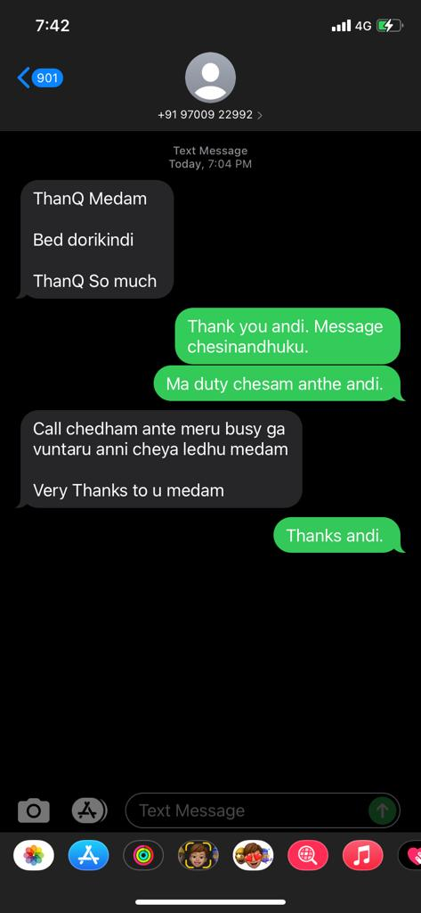
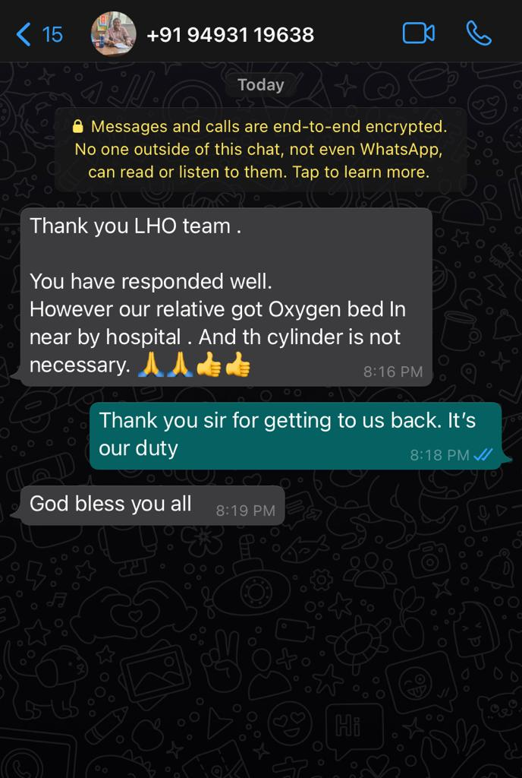
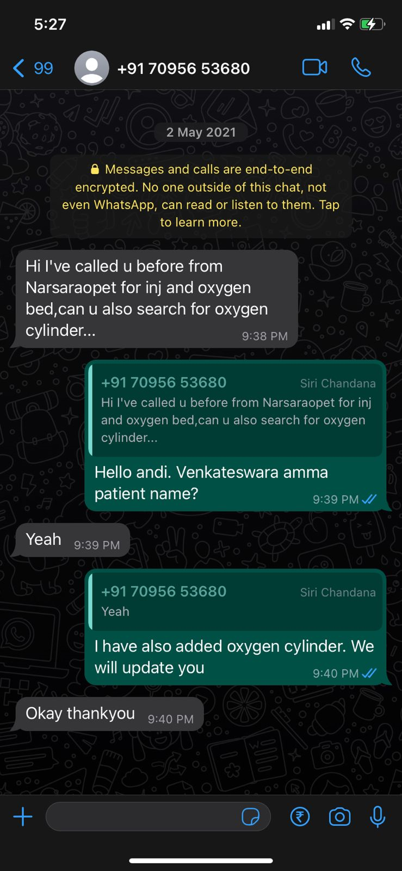
The Response We Have Received From The People

Slide 9
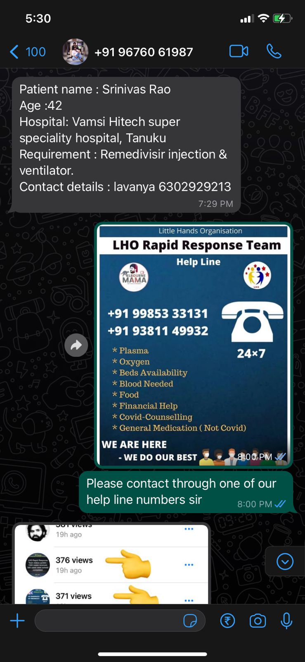
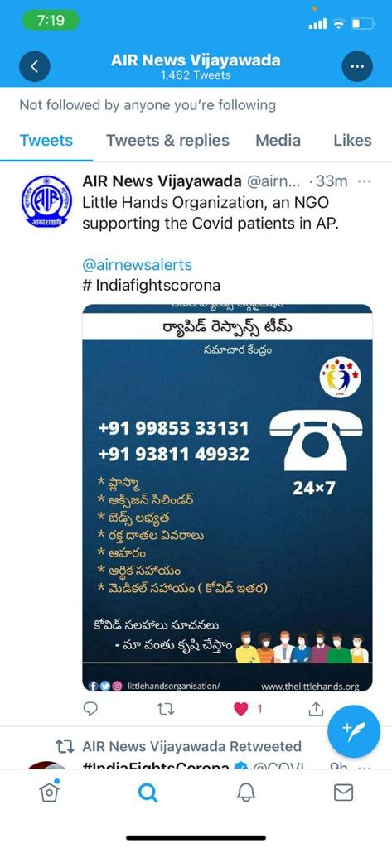
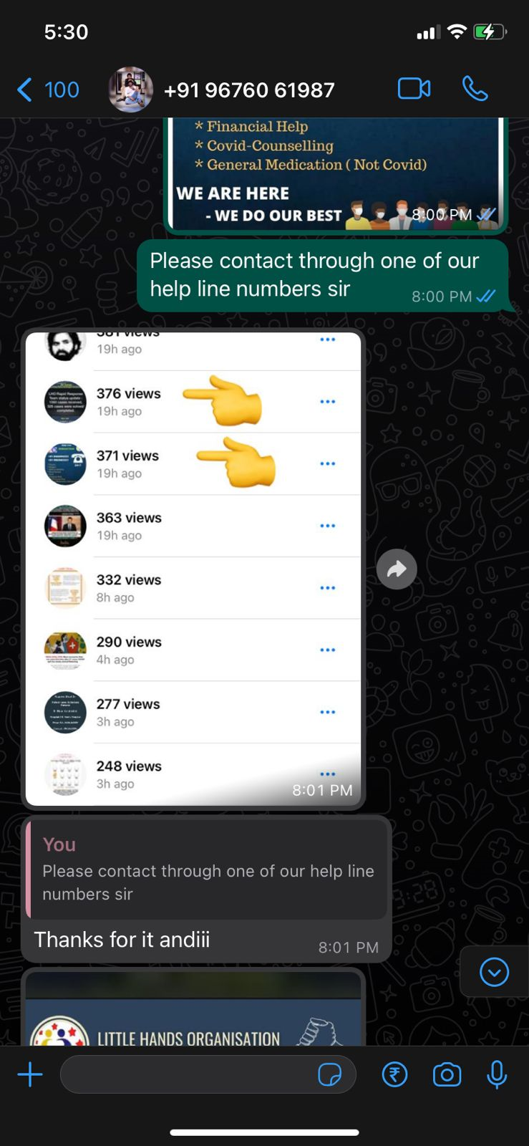

Slide 10
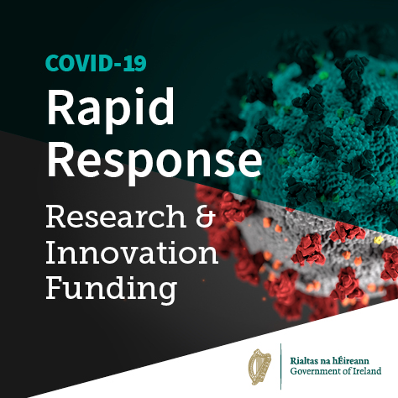
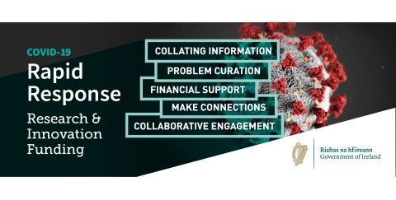
Rapid Response Guidence:

Slide 11
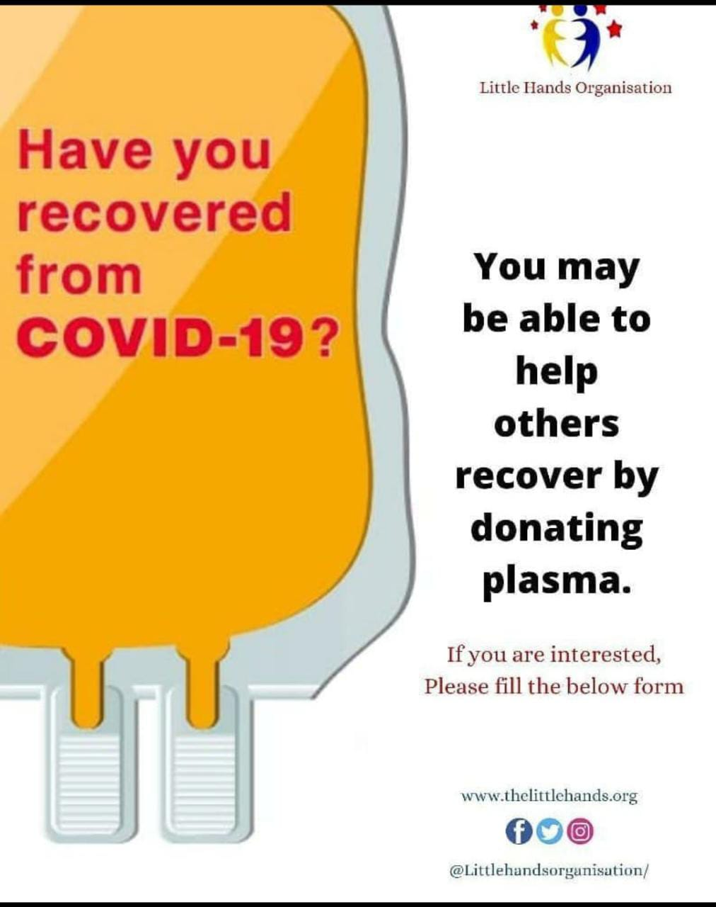
What is plasma in blood?
Plasma is the liquid portion of blood. About 55% of our blood is plasma, and the remaining 45% are red blood cells, white blood cells and platelets that are suspended in the plasma.
Plasma is about 92% water. It also contains 7% vital proteins such as albumin, gamma globulin and anti-hemophilic factor, and 1% mineral salts, sugars, fats, hormones and vitamins.
What is a plasma donation?
In a plasma-only donation, the liquid portion of the donor’s blood is separated from the cells. Blood is drawn from one arm and sent through a high-tech machine that collects the plasma. The donor’s red blood cells and platelets are then returned to the donor along with some saline. The process is safe and only takes a few minutes longer than donating whole blood.
Donated plasma is frozen within 24 hours of being donated to preserve its valuable clotting factors. It can be stored for up to one year and thawed for transfusion to a patient when needed. Red Cross donations are often used directly for hospital patient transfusions, rather than pharmaceutical uses.

Slide 12
THANK YOU

